Slide 1

Writing the
Programs
Shari L. Pfleeger
Joann M. Atlee
4th Edition

Slide 2
Chapter 7 Objectives
Standards for programming
Guidelines for reuse
Using design to frame the code
Internal and external documentation

Slide 3
Programming as a Challenging Task
All detailed issues have not been addressed
Structures and Relationships that are easy to draw may not be straightforward to program
Code understandable for others
Benefit from characteristics of design as well as keeping the code reusable

Slide 4
7.1 Programming Standards and Procedures
Standards for you
  methods of code documentation
Standards for others
  Integrators, maintainers, testers
  Prologue documentation
Matching design with implementation
  Changes in design can be easily implemented in code
    Carry forward the design’s modularity

Slide 5
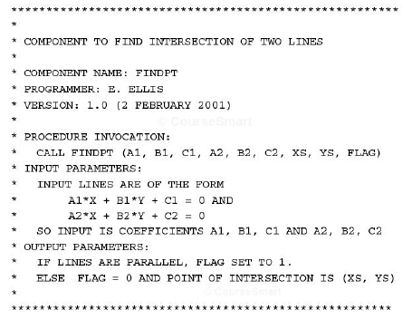
7.1 Programming Standards and Procedures
Prologue Documentation

Slide 6
7.2 Programming Guidelines
Control Structures
Make the code easy to read
  Reader should not worry about understanding the control flow
  Reflect the design’s control structure

Slide 7
7.2 Programming Guidelines
Example of Control Structures
Control skips around among the program’s statements
    benefit = minimum;
    if (age < 75) goto A;//may be a function call
    benefit = maximum;
    goto C;
    if (AGE < 65) goto B;
    if (AGE < 55) goto C;
    A: if (AGE < 65) goto B;
    benefit = benefit * 1.5 + bonus;
    goto C;
    B: if (age < 55) goto C;
    benefit = benefit * 1.5;
    C: next statement
Rearrange the code
      if (age < 55) benefit = minimum;
      elseif (AGE < 65) benefit = minimum + bonus;
      elseif (AGE < 75) benefit = minimum * 1.5 + bonus;
      else benefit = maximum;
Restructuring

Slide 8

7.2 Programming Guidelines
Control Structures
Make the code not too specific, and not too general
  Specific enough to be understood, generic enough to be re-used
Use parameter names and comments to exhibit coupling among components
Make the dependency among components visible

Slide 9
7.2 Programming Guidelines
Algorithms
Common objective and concern: performance (speed)/execution time
Efficiency may have hidden costs
  cost to write the faster code
  cost to test the code
  cost to understand the code
  cost to modify the code
Do not sacrifice clarity and correctness for speed
Learn compiler’s way of optimization

Slide 10
7.2 Programming Guidelines
Data Structures
Several techniques that used the structure of data to organize the program
  keeping the program simple
  using a data structure to determine a program structure

Slide 11
7.2 Programming Guidelines
Keep the Program Simple
Example: Determining Federal Income Tax
For the first $10,000 of income, the tax is 10%
For the next $10,000 of income above $10,000, the tax is 12 percent
For the next $10,000 of income above $20,000, the tax is 15 percent
For the next $10,000 of income above $30,000, the tax is 18 percent
For any income above $40,000, the tax is 20 percent
      tax = 0.
      if (taxable_income == 0) goto EXIT;
      if (taxable_income > 10000) tax = tax + 1000;
      else{
      tax = tax + .10*taxable_income;
      goto EXIT;
      }
      if (taxable_income > 20000) tax = tax + 1200;
      else{
      tax = tax + .12*(taxable_income-10000):
      goto EXIT;
      }
      if (taxable_income > 30000) tax = tax + 1500;
      else{
      tax = tax + .15*(taxable_income-20000);
      goto EXIT;
      }
      if (taxable_income < 40000){
      tax = tax + .18*(taxable_income-30000);
      goto EXIT;
      }
      else
      tax = tax + 1800. + .20*(taxable_income-40000);
      EXIT;

Slide 12
7.2 Programming Guidelines
Keep the Program Simple Example (continued)
Define a tax table for each “bracket” of tax liability
Simplified algorithm
  for (int i=2, level=1; i <= 5; i++)
  if (taxable_icome > bracket[i])
  level = level + 1;
  tax= base[level]+percent[level] * (taxable_income - bracket[level]);
Bracket | Base | Percent
0 | 0 | 10
10,000 | 1000 | 12
20,000 | 2200 | 15
30,000 | 3700 | 18
40,000 | 5500 | 20

Slide 13
7.2 Programming Guidelines
General Guidelines to Preserve Quality
Employ pseudocode
Revise and rewrite,
Reuse

Slide 14
7.2 Programming Guidelines
Consumer Reuse(Developed for other projects)
Four key characteristics to check about components to reuse
  does the component perform the function or provide the data needed?
  is it less modification than building the component from scratch?
  is the component well-documented?
  is there a complete record of the component’s test and revision history?

Slide 15
7.2 Programming Guidelines
Producer Reuse(subsequent apps)
Several issues to keep in mind
  make the components general
  separate dependencies (to isolate sections likely to change)
  keep the component interface general and well-defined
  include information about any faults found and fixed
  use clear naming conventions
  document data structures and algorithms
  keep the communication and error-handling sections separate and easy to modify

Slide 16
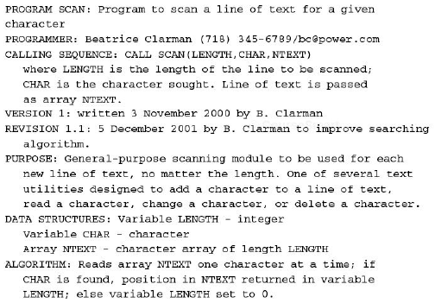
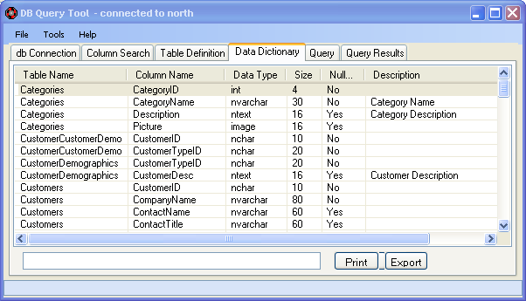
7.3 Documentation
Internal documentation
  header comment block
  meaningful variable names and statement labels
  other program comments
  format to enhance understanding
  document data (data dictionary)

Slide 17
7.3 Documentation
Information Included in Header Comment Block
What is the component called
Who wrote the component
Where the component fits in the general system design
When the component was written and revised
Why the component exists
How the component uses its data structures, algorithms, and control

Slide 18
7.3 Documentation
External documentation
  describe the problem
  describe the algorithm
  describe the data

Slide 19
7.4 The Programming Process
Documentation is still essential in agile-methods
  Assists the developers in planning, as a roadmap
  Helps describe key abstractions and defines system boundaries
  Assists in communicating among team members

Slide 20
Disclaimer
Minor modifications have been made in content and flow of UCF slides

